Slide 1
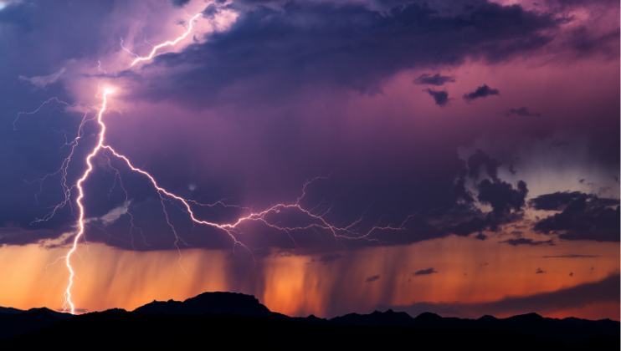
Opening ourselves to the power of nature
Nature and mental well-being
Notes:
It can sometimes take a natural disaster for us to appreciate the full power of nature. We are often insulated from nature in our centrally heated homes, air conditioned cars and modern lighting system that allow us to continue all our activities whatever the time of day. We also have food, readily available in our local shop. Because of this we can become separate from nature. Nature can sometimes only be seen as something ‘out there’ or ‘outdoors’ that we take a trip to see or go into our garden to be ‘in nature’. However, nature is all around us and the power of nature and the natural world is everywhere if we look for it. This webinar will explore the power nature has to support our mental wellbeing. It will help guide us in how and where to look to open ourselves to the power of nature.
Poll question 1

Slide 2
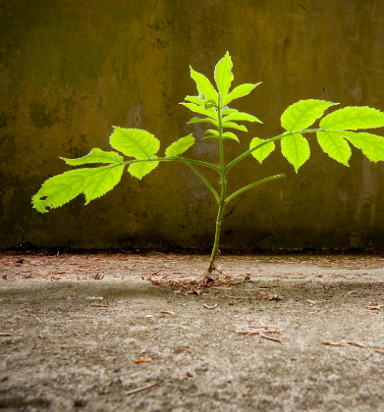
What is nature?
Nature refers to the physical world and to life in general...
The term often refers to the "natural environment" or wilderness - wild animals, rocks, forests, beaches and general areas that have not been substantially altered by humans, or which persist despite human intervention.
Notes:
Nature is broader than just being outside or finding a green space. Nature is about something happening outside of human control; the forces of nature like the wind and the rain, the power of water in a waterfall or a tree stretching upwards. It is the tiny seed that grows into tomatoes you can eat, the tadpoles that become frogs, the dark clouds clearing and the sun shining through. It is about those moments of awe when you appreciate the power and beauty of the natural world. When we gain a different perspective on the world and sometimes our lives too.
We cannot survive without nature, we physically need the sun, the rain, the plants, the sea in order to live. And research is increasingly showing that we need nature for more than just our physical survival. We need nature in order to stay mentally well.

Slide 3
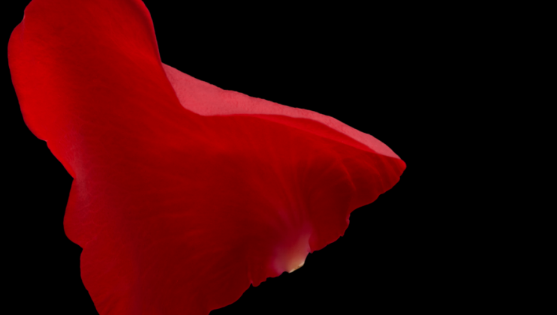
Mindfulness
Experiencing Nature
Social connections
Physical activity
Learning
Notes:
Mind suggest that there are 5 pillars of good mental health. All 5 interact and can amplify the benefits of each other. Being outside and experiencing nature can help us strengthen all 5 of the pillars that give the foundation for good mental wellbeing. There is a you tube video in the resources section of this webinar that shows how spending time in nature helped a person called Joe overcome his state of mental ill heath.

Slide 4
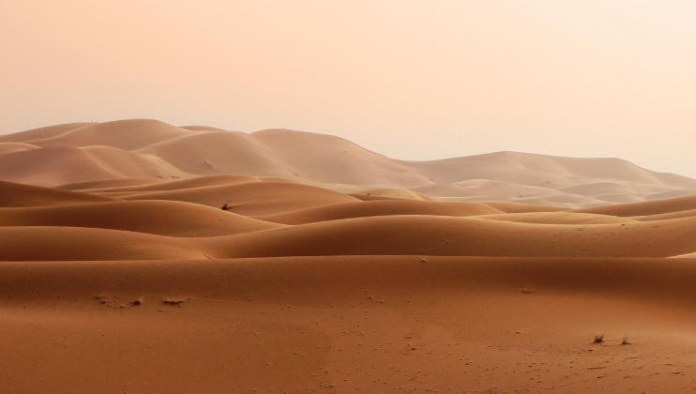
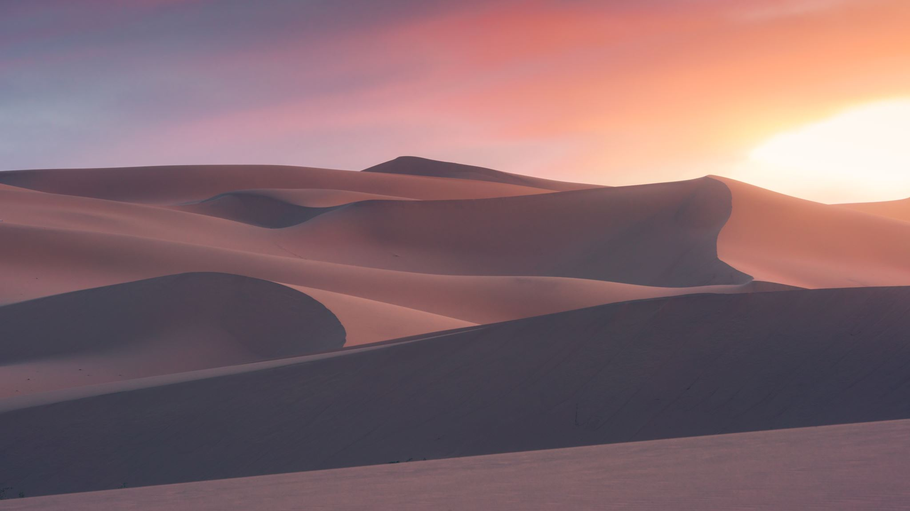
How does nature improve mental wellbeing?
Soothes us
Reduces mental fatigue
Lifts our mood
Inspires us
Sense of awe
Helps us to relax
Improves focus and concentration
Reduces symptoms of stress and anxiety
Reduces depression
Increases immune responses
Notes:
Here are some of the ways that nature benefits our mental wellbeing. Research shows that as little as 10 minutes sitting in a park can result in positive changes to our wellbeing!

Slide 5
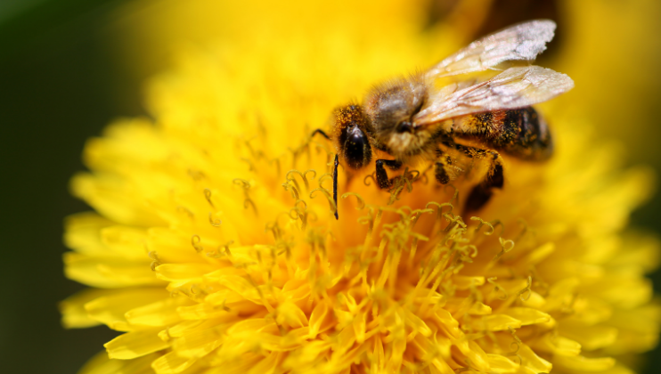
Experiencing Nature
Time in green spaces
Finding nature in urban areas
Interacting with wildlife
Gardening, conservation and farming
Creativity
Bringing nature into your work and home
Notes:
There are lots of things we can do to experience nature and it doesn’t always involve going outside. Studies have shown that looking at pictures of nature or listening to sounds from nature can also be beneficial. If you are able to go out then simply spending time in green spaces will benefit you; sitting on a park bench or going on a cycle or walk is good.
Nature can be found in the most unlikely of places – spotting those plants that manage to grow against all odds on a concrete wall or in cracks in the pavement can be admired and celebrated for their tenacity to grow. Listening to bird song, watching insects move from flower to flower or just watching the clouds pass by can all help you feel more restful.
We can also get benefit from interacting with wildlife: putting food and water out for the birds, red squirrels, or hedgehogs. Learning the names of trees, birds or butterflies.
Time spent nurturing our gardens or growing a plant or seed in a pot can be beneficial. Watching plants change across the seasons and enjoying the bloom of flowers or harvest of vegetables all have a positive impact on our mental wellbeing.
Wood carving, stone sculptures, painting and photography done outdoors can also help boost or mental wellbeing.
Poll question 2

Slide 6
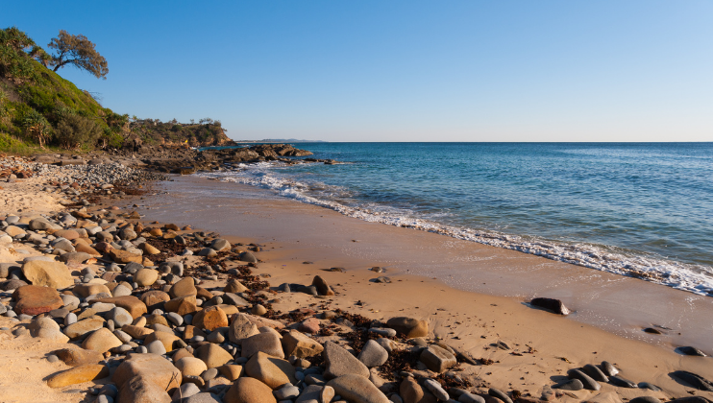
Mental fatigue
Less stimulation
Curves and shapes
Varied visual perspective
Colours in nature are soothing and calming
Notes:
In a work environment or when in a busy urban setting we are more stimulated. More people, more things that catch our attention or to be aware of. We are constantly having our attention drawn by activities, adverts, conversations, traffic etc In order to manage this overload of sensory information we have to concentrate and zone out of the huge array of stimulation around us. We do this automatically and usually do not notice that we are doing this. However our mind is having to work quite hard to sift through the huge amount of information coming in and we can become mentally because of this.
When we are in a setting such as, sitting on the beach or walking in a wood, there is much less stimulation and our minds can relax. The colours, shapes and perspectives available in nature have been found to be calming to our nervous systems and again help to relax us, helping with mental tiredness. Colours most commonly found in nature are most soothing – greens and blues, in particular are soothing to us. When we stand and look out over a natural environment we often get a rich depth of visual perspectives, you can see in the distance and the land or sea rolling out before you.

Slide 7
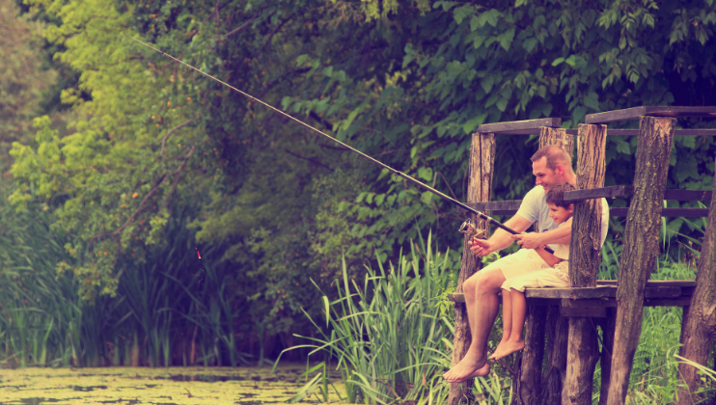
Relaxation
Calms our nervous system
Helps us to open to connection
Changes our perspective
Helps us to ‘let go’
Notes:
When we become stimulated because of the noise, activity, environment or demands placed upon us, it is our sympathetic nervous system that is triggered. This is part of the nervous system that energises us and prepares us biologically for action and activity. When we become stimulated our bodies release the hormones (adrenaline and cortisol) that go around the body and get all our systems ready for some action. Our heart will be beat faster, we will breath more rapidly, our muscles become tense and our mind becomes more alert. In the short term this is incredibly helpful and means we can rise to the challenges that we face. Biologically though, we are programmed to have a period of activity, deal with the challenge and then our body ‘stands down’ and we can rest and recuperate. Our hormone (adrenaline and cortisol) levels return to normal, our body systems slow down and our mind is no longer on high alert.
In the modern world though, many of our mental challenges not often just ‘dealt’ with and we may be overstimulated for a long period of time through work or personal stressors. This means it is harder for our bodies and minds to get to the point where they can ‘stand down’, once the challenge has been met because the challenges are often ongoing.
We need to help our bodies and mind by consciously planning in times where it can ‘stand down’ and have a break. We can do this by engaging with the natural world.
The sounds, smells, sensations and beauty found in nature as well as the sense of wonder and awe activates the part of the nervous system that slows everything down. It is the part that signals to the body systems to ‘stand down’ and then helps the body to relax and recuperate.
Our nervous system is also calmed when we connect with other people. This happens when we smile at each other and when we hear soothing words or sounds directed at us. When we are ‘standing down’ we are more receptive to opening up and connecting with others. Being over stimulated and in a high alert mode means we are less likely to reach out or connect with each other. There is a double benefit then of nature helping us to ‘stand down’ and this in turn allowing us to be more receptive to connections which in turn helps us feel supported and our bodies and mind relaxing further.

Slide 8
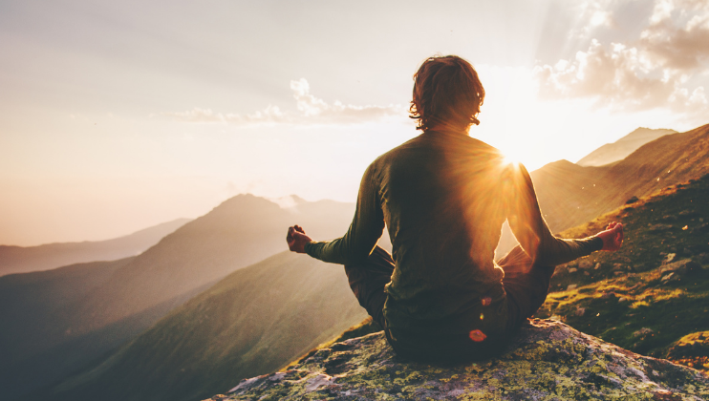
Mindfulness and Relaxation
Focusing our attention on aspects of nature
Using all of our senses: seeing, hearing, tasting, touching, smelling
Breathing
Relaxing
Notes:
Take time to focus your attention on what you are experiencing. Using all of our senses we can gain a more vivid experience. Helps us to connect more strongly to our experience and notice aspects we hadn’t seen before. Taking the time to just be in nature: sitting or walking and enjoying the time away from other pressures and responsibilities.
Poll question 3

Slide 9
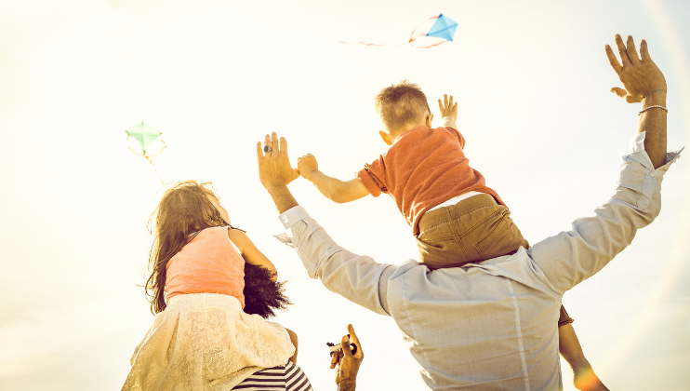
Exercise
Formal activities such as sports or workouts
Walking
Gardening
Hobbies such as cycling or, kite or model aircraft flying
Notes:
We don’t have to do formal exercise outside for it to be beneficial. Any physical movement will enhance our wellbeing. Anyone who has had an afternoon digging in the garden knows how physical gardening can be! Equally we can be physically active in ways we don’t realise when we are with the grandchildren in the playground or on the beach (it is surprising how tiring all the kneeling and making of sandcastles can be!) or spending time flying a kite.

Slide 10
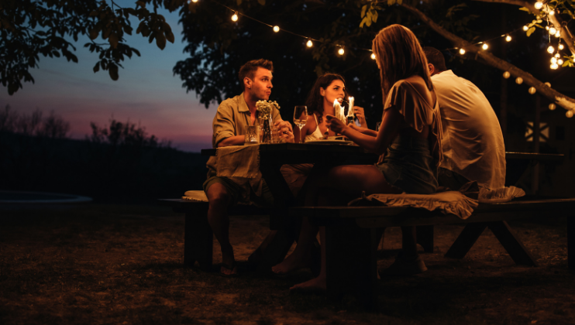
Social connection
Picnics or barbecues with friends or family
Alfresco meals
Coffees in the garden, park or at the beach
Team sports or group activities such as sea swimming groups
Walks, cycle rides or runs with other people
Sitting and chatting outdoors
Notes:
Social connections: soothing parasympathetic nervous system, laughter and fun (oxytocin), sharing experiences together etc

Slide 11
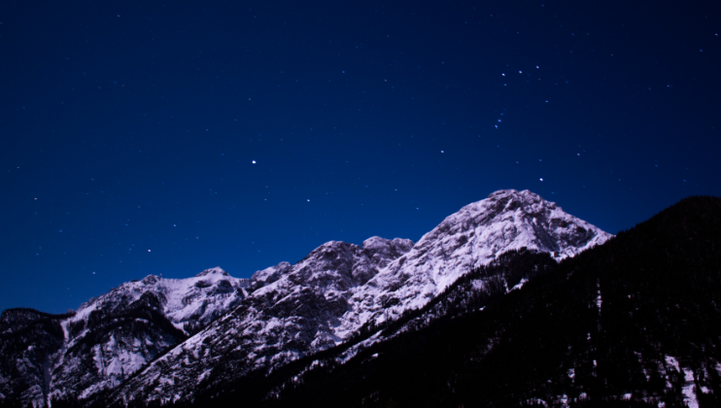
Learning
Names of birds, trees, mountains, flowers, star constellations
The natural world: weather, tides, wind, geography
History of an area
A new skill: sea swimming, running, climbing, cycling, photography, fishing
About yourself

Slide 12
What can I do?

Slide 13
Action plan
Choose an activities in nature that you feel is possible
When can you achieve this by?
What one step can you achieve in the next 24 hours?
What one thing can you do right now?
Notes:
Now you have heard of the benefits of being in nature, what changes are you going to make? Bearing in mind what we’ve discussed and you are spending time in nature, what adjustments you make to spend more time outdoors or be more active in nature than you are now. Be adventurous and creative, write anything down or hold in your mind anything that comes into you head. Now, pick one activity from your list that you’d like to focus on and action. When do you think you could action this by? What could you do it in the next 24 hours towards achieving this? So by this time tomorrow what small step can you take towards this action? Could you do one thing right now to start this process – write a note, download an app, contact a friend to do a walk outside, If you have a partner suggest a trip at the weekend/evening outdoors. If you have made plans to do that, you’ve taken a step to improving your mental well-being!

Slide 14
Armchair nature
Sitting and looking out the window or open door
Bird feeders on windowsills
House plants
Pictures of nature scenes
TV programmes about nature
Listening to sounds – for example, on apps
Burners or diffusers of natural scents
Notes:
Some of us are not able to leave the house easily. We may find it hard physically or mentally to go outside and experience nature in this way. There are still heaps of things we can do though. That also includes things we can do if we have to spend a lot of time inside working.

Slide 15
Associations
Notes:
When our brains store memories of events they also store all the associated senses and feelings you have about the event as well. This means that any memory of an event can also conjure up memories of how you were feeling at that time. We are probably all familiar with this, remembering a family holiday by the beach can bring back the feelings of joy or contentment we had at the time.
We can use the way our brains store memories to enhance the benefits of our experiences of the natural world. Most of us will be able to come up with a memory where we visited a particular location on holiday. We can ‘trick’ our brains to believing that we are right back there on that beach, hearing the waves and feeling the warmth of the sun. Just by spending the time imagining being back in these special and safe places can help us to relax.
There are also lots of guided visualisations that can support us in imaging places in the natural world. Imagining these visualisations helps us to focus our mind on places in the natural world which tricks the brain into believing that we are actually there and evokes the sensations of relaxation in our bodies. If you focus really hard you might be able to feel the sensations and emotions you would if you were actually there.

Slide 16
Summary
Notes:
Nature is all around us. It is beautiful, life enhancing and healing……when we open ourselves up to the power of nature we are opening ourselves to better mental well-being. Lets ho and enjoy it

Slide 17
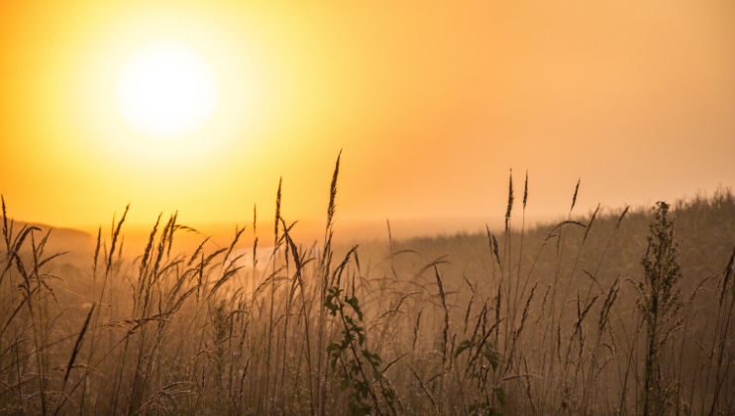
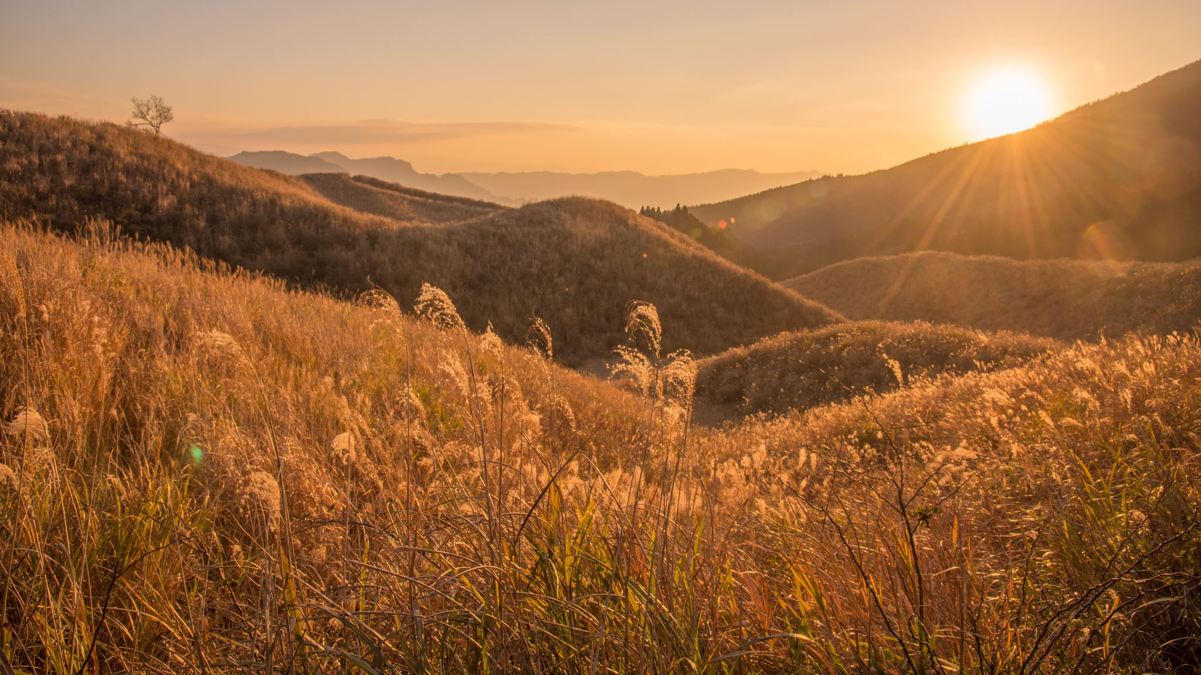
Questions?

Slide 18
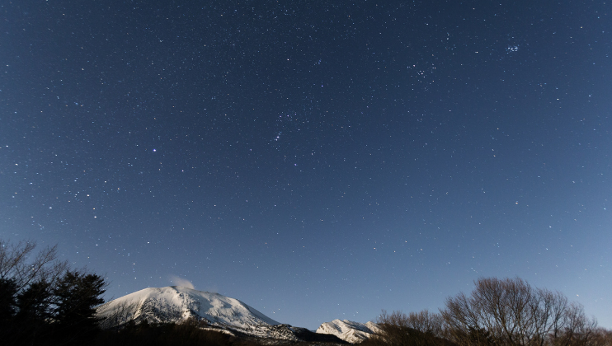
Thank you
Notes:
Rather than share resources here we have added a link to more resources available on our website.

